Slide 1
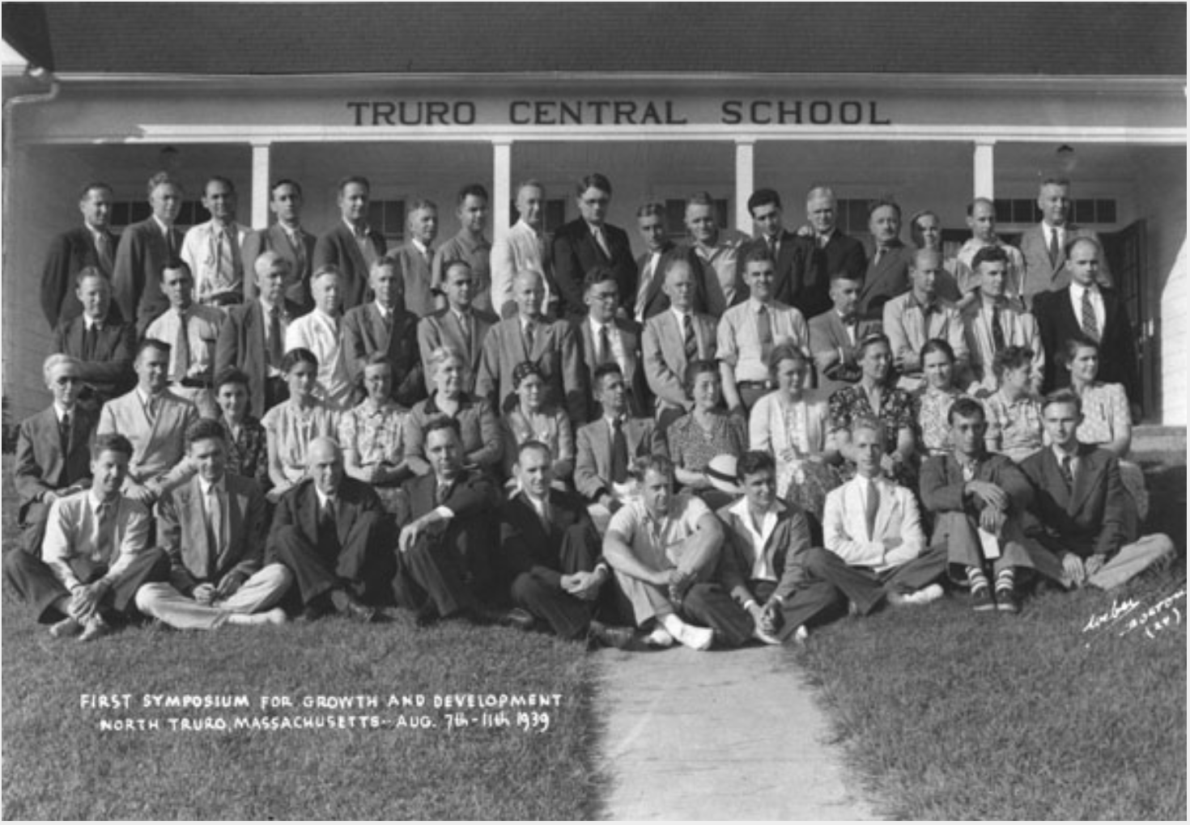
Society for Developmental Biology
Members
Academic researchers
Postdoctoral fellows
Graduate students,
Undergraduate researchers
Affiliated members
https://www.sdbonline.org/
Notes:
https://www.sdbonline.org/

Slide 2
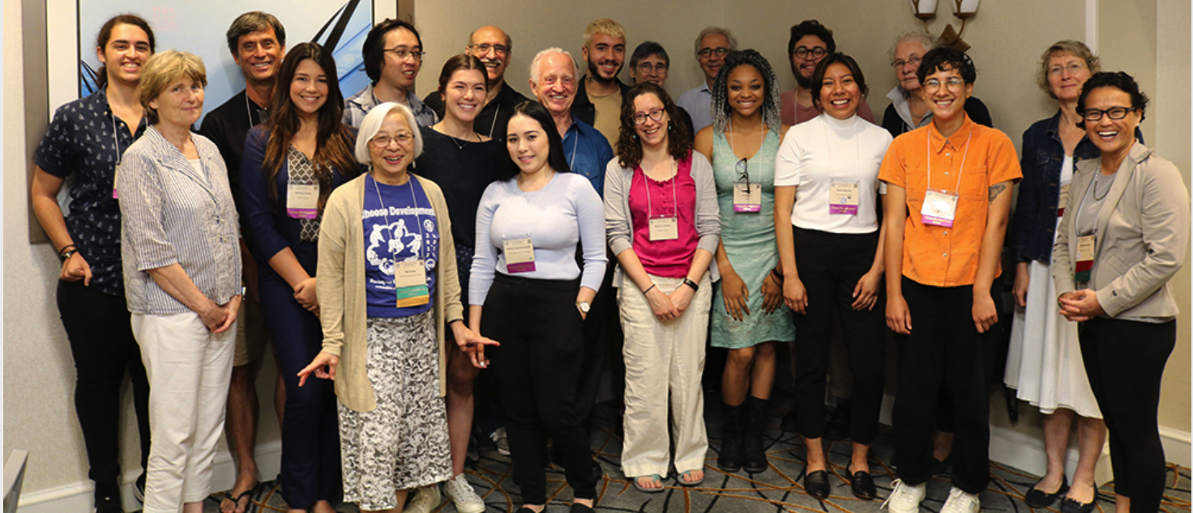
SDB priorities
Provide programs that are inclusive for all members, at all levels in developmental biology and related areas.
Choose Development! Program – launched in 2013
Annual and regional meetings
https://www.sdbonline.org/choose_development
https://www.sdbonline.org/mission
Notes:
https://www.sdbonline.org/choose_development

Slide 3
SDB recent successes and in progress
Targeted Program
- Just funded by NICHD ! Choose Development:
Professional online workshops
- May 2022 – GetHIRED :
- Inclusion and education symposia
Website
Under construction
https://www.sdbonline.org/choose_development
https://sdbonline.org/gethired
Notes:
https://www.sdbonline.org/choose_development
https://sdbonline.org/gethired
: https://www.sdbonline.org/gethired

Slide 4
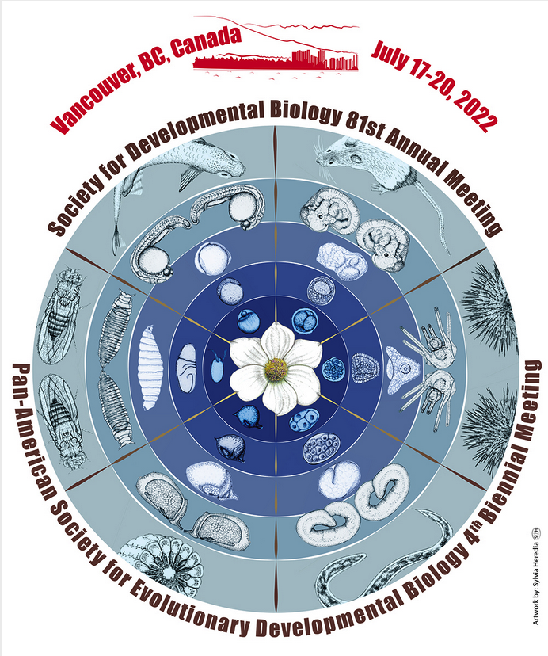
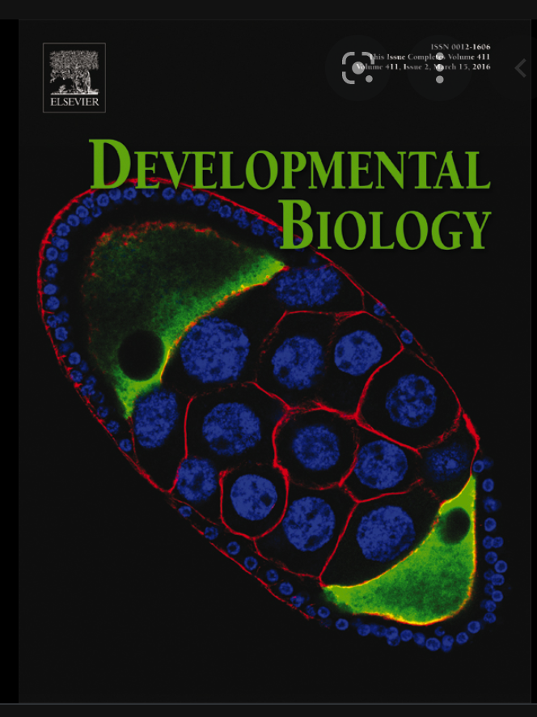
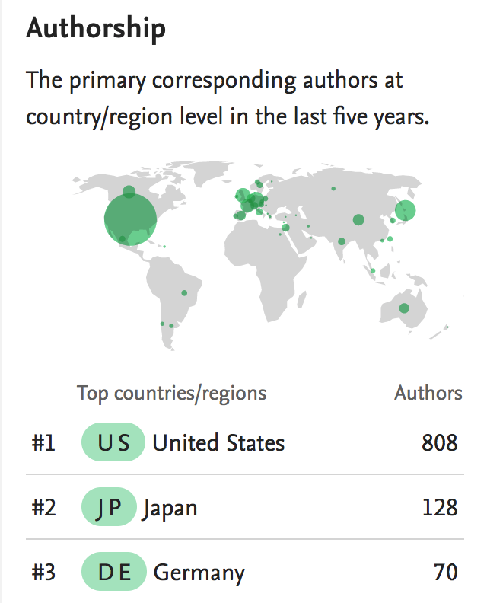
SDB journal and meetings
Journal: Developmental Biology
- Established in 1959
Meetings:
- Annual: Vancouver
- Regional (NE, MA, NE, MW)
https://www.sciencedirect.com/journal/developmental-biology
Notes:
https://www.sciencedirect.com/journal/developmental-biology
https://www.sciencedirect.com/journal/developmental-biology

Slide 5
SDB challenges
Broaden income sources/resources independent of publishing
Continue to recruit and engage the next generation of developmental biologists
- Perception:
“Since its heyday in the 1980s and 90s, the field of developmental biology has gone into decline; in part because it has been eclipsed by the rise of genomics and stem cell biology, and in part because it has seemed less pertinent in an era with so much focus on translational impact “
- A need to ‘rebrand’ developmental biology for younger generations
Daniel Johnston
Notes:
Rebranding of dev biol

Slide 6
Relation between FASEB and SDB
Benefit of FASEB membership:
Public affairs (Capitol Hill, letters to NIH and congress, …)
FASEB initiatives e.g. DataWorks, DEIA efforts
Visibility
Two-way benefit:
- FASEB adopted SDB’s moratorium on cloning human beings

Slide 7
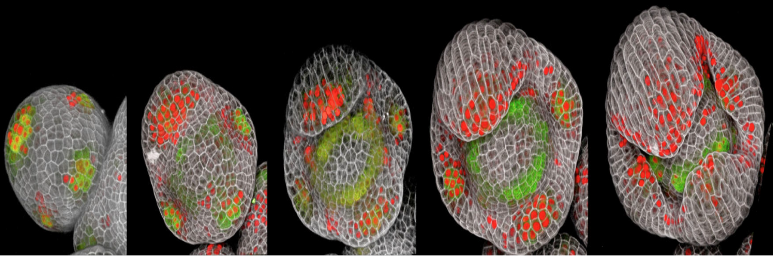
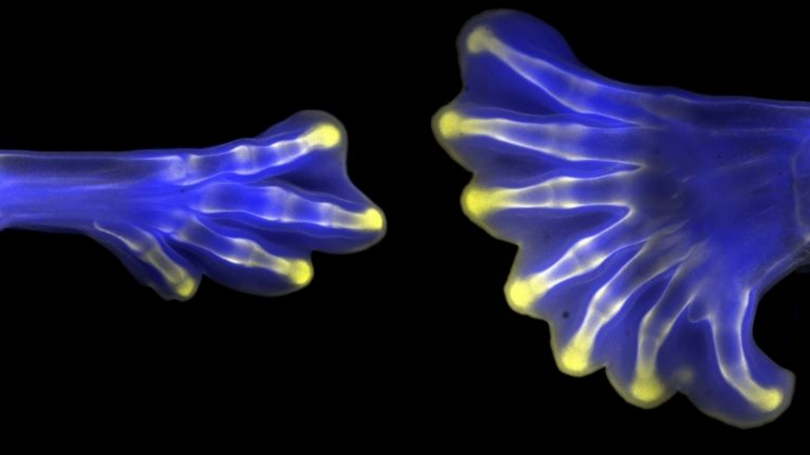
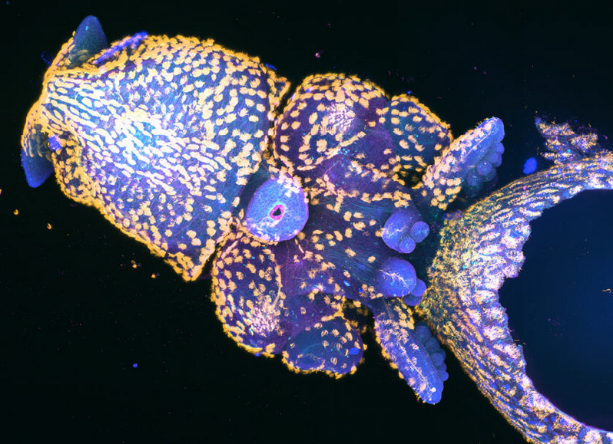
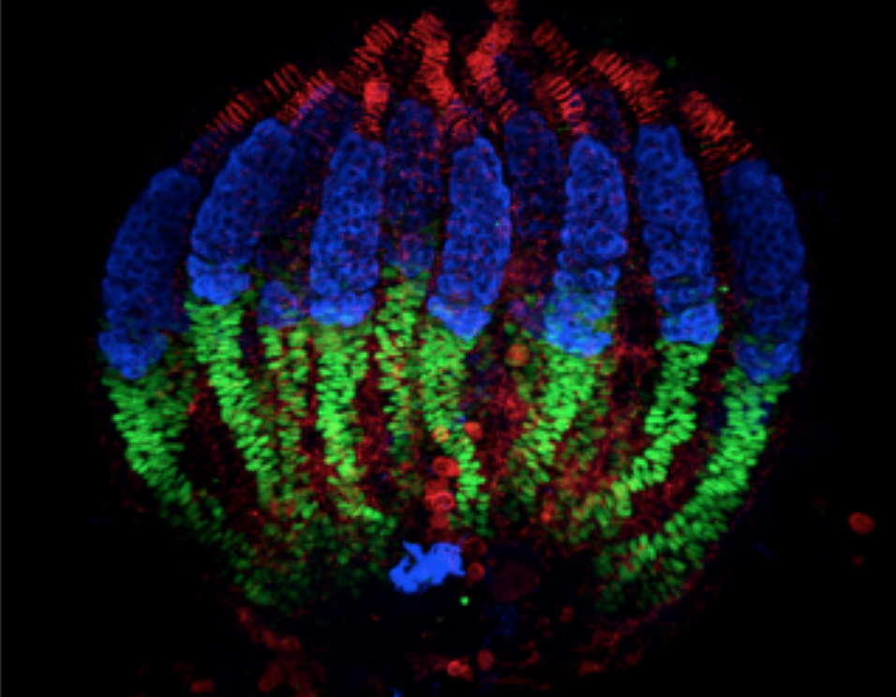
SDB winners of FASEB photography contest
Nathanaël Prunet
Christian Bonatto
Zuzana Vavrušová
Abigail Dove

Slide 8
Thank you !
https://www.sdbonline.org
Notes:
https://www.sdbonline.org

